Slide 1
LOCATION RECOMMENDATION FOR A SOUVENIR SHOP in Danang city
Cao Thi Nham

Slide 2
Contents
Introduction
Data sources
Methodology
Results
Conclusion

Slide 3
Introduction
Background
Danang is one of the most attractive location for tourists in Vietnam
There are more than 6 million arrivals to this city annually
Business with a souvenir shop is potentially successful
Locations are an important factor
It is difficult to obtain information that will guide investors to find a suitable place to start business
Problem
Assuming that locations with high visitor density is potential for doing business with a souvenir shop
Using checkins data of venues in Danang city may contribute to determine suitable locations for a souvenir shop
Interest
Investors would be very interested in the map that show potential locations for their prospective souvenir shop

Slide 4
Data sources
Data from Foursquare
Get venue id, venue coordinates, venue name
Get numbers of checkins for each venue in the city

Slide 5
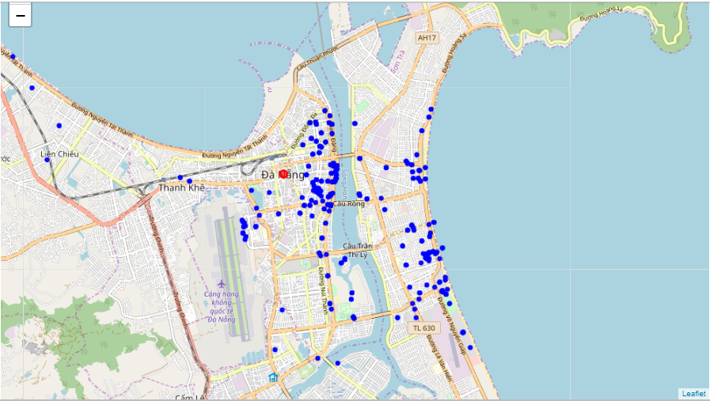
Methodology
Visualize the distribution of venues

Slide 6
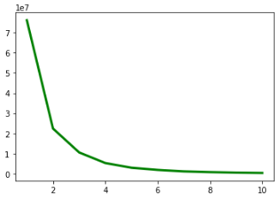
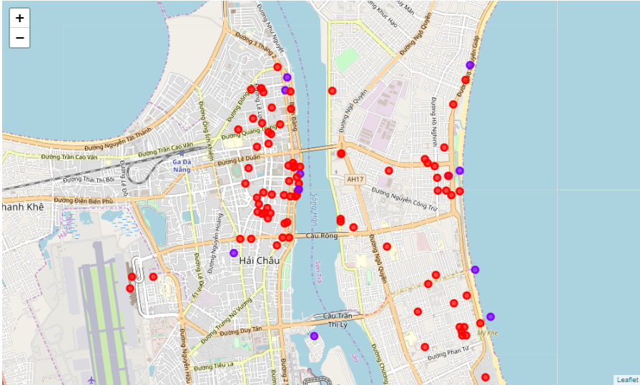
Methodology (cont.)
Use k-mean to cluster venues
Find the optimal value for k
K=2
Segment and visualize clusters on the map.

Slide 7
Conclusion
Based on the map, the optimal to start a business with souvenir shops are high density of visitors as highlight on the map.

